Slide 1
The Battle of Neighborhood -New Restaurant in Capital Region, NY

Slide 2
Background
ALBANY — The Capital Region is an oasis of population growth in upstate New York since 2010, according to the most recent estimates by the U.S. Census Bureau
The high-tech, health care and higher education sectors are feeding the Capital Region’s expansion, according to local experts
“The only area outside of New York City that has job growth is the Capital Region,” said Mark Eagan, CEO of the Capital Region Chamber. "Our private sector job growth is above all the other metropolitan areas in the New York.“
This growth placed the Capital Region in the ranks of most counties across the nation that saw population growth, as foreign migration into our area offset the loss of those who moved elsewhere.

Slide 3
Goal of this project
Given the economic and population growth in Albany, there’s good opportunity to investigate new business, such as opening new restaurant
This project is trying to analyze the neighborhood data in Albany region and identifying candidate spots for new restaurant
We plan to identify locations where the place is close to popular venues, without too many existing competitions, and in a safe region

Slide 4
Source of the data
Albany criminal record: From government website https://data.albanyny.gov/Public-Safety/APD-Arrests-Dataset-by-Neighborhood/7y34-47cz
Albany top venues and restaurants:
from foursquare location data

Slide 5
Methodology
Extracting raw data from government website, and using Panda for data manipulation, using folium map to highlight and label locations with criminal incidents and grouping nearby criminal counts to obtain frequency pattern
Using Foursquare API to retrieve top venues. Separating top venues into restaurant and non-restaurant, and using folium map to plot all information together

Slide 6
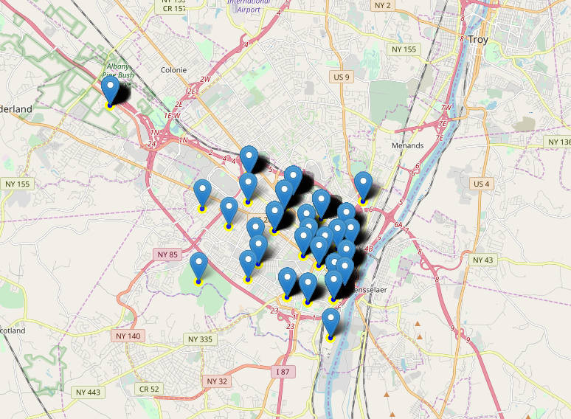
Results
Here is the criminal location data with label in Albany region

Slide 7
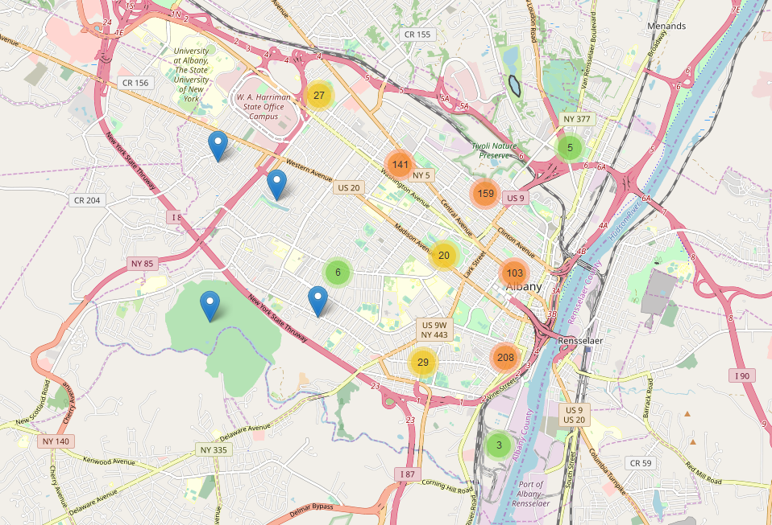
Results
Here is the criminal incident frequency in various neighborhood in Albany area

Slide 8
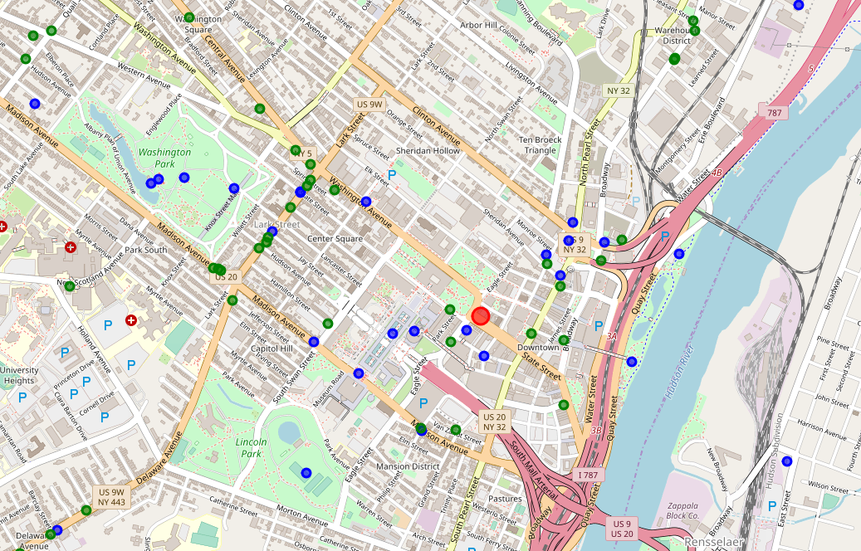
Results
Here are the top venues in the Albany region. Blue is non-restaurant, green is restaurant

Slide 9
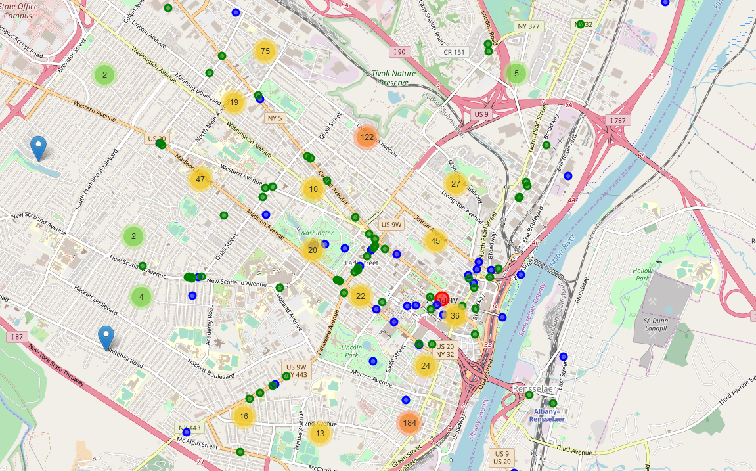
Results
Here is consolidated map including top venues together with criminal frequency map

Slide 10
Discussion and Conclusion
Our goal is to determine best location for a new restaurant. The ideal place of a new restaurant should have following criteria: (1) It is close to hot venues (2) Not many existing restaurants nearby to compete customers (3) It is in a safe area.
From the consolidate map, a few top candidate places for new restaurants are: (1) Watervliet Avenue Extension (2) Intersection of South Swan Street and Madison Avenue (3) Intersection of Chapel Street and Clinton Avenue

